Slide 1
Simple Numbers:
Rules for Surviving and Thriving in a Crisis
Developing a Plan on Funding Needs
WORD BY VERNE HA FINISH
SIMPLE NUMBERS, STRAIGHT Till
BIG PROFITS! GREG CRABTREE
Greg Crabtree, CPA
Greg.Crabtree@cricpa.com www.simplenumbers.me 256-704-0620

Slide 2
What Do We Do Now?
Create a 90 Day Plan
• Forecast through the initial 90 days of uncertainty
Create a 180 Day Plan
• Will consumers immediately return after 90 days? Or slowly scale up?
• Evaluate cash required. Is it readily available? Will we need to borrow? Is it worth it?
EVALUATE

Slide 3
Art of Forecasting in Crisis
Plan out monthly gross margin first
Look a non-labor expenses second to see what can be turned off or delayed
Look a direct labor to what is needed to operate
Look at management labor last
Evaluate resources and runway consider cash, access to debt or disaster loan assistance and then decide if you can support more labor at full or reduce pay or if you have to cut faster.

Slide 4
Profit is Different than Cash Flow
■ Every business model has a distinct profit and cash flow signature
■ In a time of crisis, you need a keen understanding of when profit turns into cash
■ Expect disruption of normal terms
■ You will get paid slower
■ You may have to pay faster
■ If you carry Accounts Receivable or Inventory, it will be easier to get loan assistance than a business that does not have those.
■ Let’s look a 3 examples

Slide 5
Do Stuff (Services)
3 Primary Business Models
Sell Stuff (Product Sales)
Make Stuff (Manufacturing)
All other models are hybrids mixing 2 or more of these.

Slide 6
Simple Numbers P&L Mode! |  | Make | Sell | Do
Revenue |  | 4.4D0,000 | 4D,000.ODD | ID,000.ODD
Cost of Goods Sold |  | 1.300,000 | 34,650.0 DD | 500,000
Gross Margin |  | 2,600,000 | 5,350,000 | 9,500.000
 | as 54? to Sales | 5Я.О9% | 13.38% | 95.00%
Direct Labor |  | 900,000 | 1,100,000 | 4.750,000
Corrtribution Margin (CM) |  | 1,700,000 | 4.250,000 | 4.750,000
dLER (GM. | as 54? to Sales / Direct Labor) | 38.64 % 2.89 | 10.63% 4.86 | 47.50% 2.00
Operating Expenses:
Facilities |  | 240,000 | 270,000 | 330,000
Marketing |  | 36, DOO | 130,000 | 160,000
Management Labor |  | 450,000 | l,5D0,000 | 1,1D0,000
Payroll taxes &. benefits |  | 130,000 | 4D0,000 | 3D0,000
Other operating expenses |  | 100,000 | 430,000 | 600,000
Total Operating Expenses |  | 1,006,000 | 2,780,000 | 3,550,000
es 54? to SaVes mLER (GM / Munagemen t Labor) |  | 22.86%, 3.78 | 6.95% 2.83 | 35.50% 4.32
Net Operating Income |  | 694.000 | 1,470,000 | 1,200 .ODD
 | as 54? to Sales as 54? to GM | 15. 77% 26.69% | 3.68% 27.48% | 12.00% 12.63%
Other Income (Expense):
Interest income |  | IjDDO | l,5D0 | 3,DD0
Depreciation |  | (100,DDO) | (75.0 DD) | (50.0 DD)
Reinvestment Expenses |  | ■■■ | (150. DDO) | (100,DDO)
Other expenses |  | (10.000) | (5.0 DD) | (15.0 DD)
Total Other Income (Expense) |  | (109 ,DD0) | (22S.5D0) | (162, DDO)
Net Income |  | 535,000 | 1,241.500 | 1,038,000
 | as 54? to Sales as 54? to GM | 13.30% 22.50% | 3.10% 23.21%, | 10.38% 10.93%

Slide 7
4 Needs for Capital
Make Sell Do
Net Income | 585,000 | 1,241,500 | 1,038,000
os St to Hewn ue | 133% | 3.1% | 10.4%
Trade Capital
Accounts Receivable | 542,465.75 | 2,191,780.82 | 1,232,876.71
Inventory | 295,890.41 | 2,847,945.21 | -
WIP | - | - | 410,958.90
Accounts Payable | (295,890.41) | (4,271,917.81) | -
Deferred Revenue | - | - | (1,095,890.41)
Net Trade Capital | 542,465.75 | 767,808.22 | 547,945.21
os St to Hewn ue | 123% | 13% | 5.5%
Infrastructure Capital (net of debt) | 250,000.00 | 750,000.00 | 100,000.00
Buffer Capital | 317,666.67 | 646,666.67 | 1,383,333.33
Required Capital | 1,110,132.42 | 2,164,474.89 | 2,031,278.54
ROIC | 53% | 57% | 51%

Slide 8
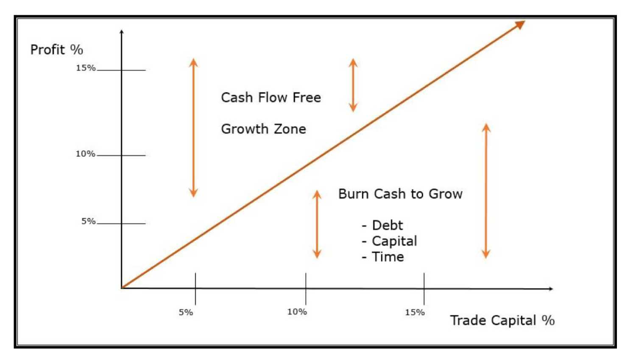
CPR: Cash Power Ratio

Slide 9
Trade Capital % compared to Profit % is the key to understanding cash flow as you scale up out of a business slump.
In Simple Numbers terminology:
Trade Capital + Buffer Capital = Working Capital
Trade Capital is forced on you by the market, Buffer Capital (Cash & Debt) are choices based on your access to resources.

Slide 10


Trade Capital -
Add: A/R + Inventory + Work Less: A/P + Accrued Expenses in Progress + Deferred Revenue
Infrastructure Capital - Investment above debt support for Equipment, Buildings and other long term assets that depreciate
4 Needs for Capital
Buffer Capital - Core Capital Target (2 months of operating expenses in cash)
Launch Capital - Losses to be funded for a new activity, startup or next stage, or temporary crisis until you break even

Slide 11
Revisiting the Four Five Forces of Cash Flow
Prioritized in order:
1. Make Reinvestments into Business at 50% ROI
2. Set Aside Tax Liability (Quarterly)
3. Repay Line of Credit (LOC) Debt
4. Core Capital Target in Reserves - 2 months of operating expenses and Direct Labor in cash with nothing drawn on Line of Credit (LOC)
5. Pay Dividends (Distributions)
This is the priority order for cash to be used from profits

Slide 12
Core Capital Target Calculation
 | Rotail/Mfg | Distribution | Services
Revenue | 4,400,000 | 40,000,000 | 10,000,000
Cost of Goods Sold | 1,300,000 | 34,650,000 | 500,000
Gross Margin | 2,600,000 | 5,350,000 | 9,500,000
as % tc Sales | 59.09%, | ?3.38% | 95.00%
Direct Labor | 900.000 | 1,100,000 | 4,750,000
Contribution Margin (CM) | 1,700.000 | 4.250,000 | 4,750,000
as °/o to Sales | 38. 64% | 10.63% | 47.50%
dLER (GM / Direct Labor) | 2.89 | 4.86 | 2.00
Operating Expenses:
Facilities | 240,000 | 270,000 | 390,000
Marketing | 36, DOO | 130,000 | 160,000
Management Labor | 450,000 | 1,500,000 | 1,100,000
Payroll taxes & benefits | 130,000 | 400,000 | 300,000
Other operating expenses | 100,000 | 430,000 | 600,000
Total Operating Expenses | 1,006,000 | 2,780,000 | 3.550,000
3s % to Sales | 22.86% | 6.95% | 35.50%
mLER. (CM / Management Labor) | 3.78 | 2.83 | 4.32
14et Operating Income | 694.000 | 1,470,000 | 1,200,000
35 % to Sales | 15.77% | 3.68% | 12.00%
as % to GM | 26.69%, | 27.48% | 12.63%
1 Month Core Capital | 153,833 | 323,333 | 691,667
2 Month Core Capital | 317,667 | 646,667 | 1,383,333

Slide 13


Launch Capital Process
Identify the initial new spend that will be the catalyst to the new activity (marketing, labor, facilities)
Forecast how much losses will be until the activity will break even. Those losses represent “launch capital”
Establish expectation of profit increase (and when) from that spend
Our standard is minimum of 50% return with 12 to 24 months

Slide 14
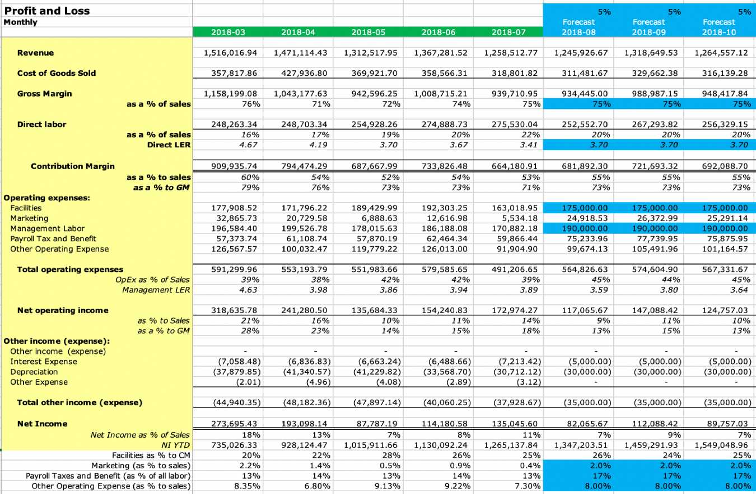
Monthly P&L Forecast

Slide 15

Surviving and Thriving in a Crisis
USING THE TEMPLATE

Slide 16
Step One: Input Actuals for P&L
Monthly Template
Profit arid Loss
¥o¥ %> change |  |  |  | 14% |  | 14% | -
 | Actual 2019-07 | Actual 2019-00 |  | Actual Actual Actual Actual Actual 2019-09 2019-10 2019-11 2019-12 2020-01 |  | Actual 2020-02 | Fo 26
Revenue Cost of Goods Sold | 229,025 12,129 | 270,425 6,091 |  | 2^ | ^5,069 3,613 | 235,000 12,825
Gross Margin as a % of sales Direct labor | 216,096 95% 90,541 | 264,334 93% 115,779 |  | Input Actual Numbers for: Revenue, Cost of Goods Sold, Direct Labor | 11,456 99% 15,169 | 272,175 96% 99,742 | 1
as a % of sales Direct LER | 43% 2.20 | 43% 2.26 |  |  | 34% 2.39 | 35% 2.73
Contribution Margin | 110,3S6 | 147,555 |  | AND | :6,287 | 172,433
аза % of sales Operating expenses: Facilities Marketing Management Labar Payroll Tax and Benefit Other Operating Expense | 52% 17,150 0,044 37,650 25,932 41,394 | 55% IB, 544 13,300 37,650 26,975 26,995 |  | Facilities, Marketing, Management Labor, Payroll Taxes & Benefits, and Other Operating Expenses | 65% 12,917 3,349 19,317 14,800 ■1,794 | 61% 22,642 9,452 38,250 27,121 39,876
Total operating expenses OpEx as % of Sales Management LER | 130,171 57% 3.14 | 123,471 46% 3.92 |  |  | 52,677 42% 6.01 | 137,341 48% 4.51 | 1
Net operating income | (11,016) | 24,034 |  | 30,149 4S,603 (14,743) 50,042 S3,610 |  | 35,092 | 1
NO! as % to Saies | -5% | 9% |  | 12% 16% -6% 16% | 23% | 12%

Slide 17
Step Two: Input Actuals for Balance Sheet
 | Monthly Template Profit and Loss Y6Y change |  | 1 | 446 14% | -424
 |  | Actual 2019-07 | Actual Actual Actual Actual Actual At 2019-08 2019-09 2019-10 2019-11 2019-12 20 | ctual Actual 20-01 2020-02 | Fg recast 2020-03
 | Balance Sheet Key Drivers
 | A/R Days Inventory Days | 55.41 |  | 34,50 45.00 | 43-0(
 |  | - |  | - - | -
 | А/P Days Deferred Revenue Days | 6.84 | ' Using your Balance Sheet, Input the following data: | 51.84 17.37 | 7.01
 | Trade Capital | 417,149 | • Amounts Receivable Days Sales Outstanding | 7,317 345,039 | 70,78(5
 | Accounts Receivable | 481,493 |  | 58,046 437,552 | 215,OOt
 | Inventory Other Current Assets | 15,051 | • Accounts Receivable • Invpntnrv | 6,603 б,6оз | 6,6o:
 | Accounts Payable Deferred Revenue | (2,764) | • Other Current Assets | (6,243) (7,426) | (l,4Ot
 | Other Liabilities | (76,631) | • Arm и nt*; Pavablp | 41,090) (141,090) | (149,41:
 | Infrastructure Capital! | 21,554 | • Deferred Revenue | 3,699 23,155 | 22,611
 | Net Book Value of Fixed Asato Debt on Fixed Assets | 21,554 | • Other Liabilities | 23,699 23,155 | 22,61:
 |  |  | • Net Book Value of Fixed Assets
 | Duffer Capital | 25B,347 |  | 9,571 426,B85 | 615,872
 | cash LOC | 258,347 | • DEOL On rlXeu ASSeiS • Cash | 39,571 426,385 ■ ' | 615,87;
 | Equity | 697,050 | • Lill IE UI LI EU IL | 0,587 795,679 | 709,269
 | Starting Equity | 708,866 |  | 76,977 760,587 | 795,67!
 | Profit (Loss) | (11,016) |  | 83,610 35,092 | (86,4 К
 | Contribution (Distribution) | (0} |  | (0) 0
Use Traditional Balance Sheet Template to convert input to the Simple Numbers Balance Sheet if needed.

Slide 18

Step Three: Revenue and GM% (PL)
■
■
Forecast Revenues
Next 90 Days
■ What is immediate impact to revenues?
After Initial 90 Days
■ Will revenue pop back up to normal operations?
■ Will revenue slowly creep back up?
■ What is long term affects on your industry and company?
■ What are affects to your competition?
■ Are there opportunities we can prepare for now to profit on ater?
■

Slide 19

Step Four: Operating Expenses (PL)
■ Forecast operating expenses
■ What operating expenses can we reduce without effecting future operations? What can we eliminate altogether?
■ Lease / Rent Expenses
■ Marketing
■ Management Labor reductions or temporary decrease in pay

Slide 20

Step Five: Direct Labor (PL)
■ Forecast Direct Labor costs (unburdened)
■ If Revenue declines, will Direct Labor also decline?
■ i.e. Pay by Job
■ Staff Reductions?

Slide 21
Step Six: Key Drivers (BS)
■ Utilize your knowledge of sector and prior performance to forecast these drivers.
■ A/R Days - If you know your customers are strongly effected (offices closed, etc), then you can assume your A/R Days will be higher than normal for the next 90 days, then returning to normal levels.
■ A/P Days - If you can extend out some of your payment terms on payables, then you should increase the AP Days.

Slide 22
Step Seven: Trade Capital (BS)
■ Forecast for Inventory, Other Current Assets, and Other Liabilities.
■ If your inventory is seasonal, link the $$ to same month prior year (with edits as needed for the crisis)

Slide 23
Step Eight: Infrastructure & Buffer Capital (BS)
■ Forecast Fixed Asset purchases, any Fixed Term Debt, and any Line of Credit balances here.
■ Note: Many Banks are deferring payments and new loans have very low interest rates.
■ SBA Disaster Loans are good for longer term financing at low interest rates.
■ Stay informed on local (City and State) resources
■ Template helps to quantify the cash flow need, given certain parameters and decisions.

Slide 24

Step Nine: Distributions & Contributions
■ Include any Tax Distributions
■ STOP Profit Distributions
■ Is there cash that can be Contributed to the
company from owner(s)? How much are you willing to invest?

Slide 25
Step Ten: Stop. Analyze.
■ Look at debt incurred and determine how long it will take to repay? Delayed gratification because once operations return to normal, still repaying debt.
■ If you have cash, if you could get a loan, how long will it take of future normal operations to repay?
■ Is it better to go dark and relaunch business at future time (fixing all the things you would do differently)? Dark could be closing doors and liquidating OR just temporarily closing business.
■ Prepare 3 versions - best, worst, expected

